Slide 1
Case study

Slide 2
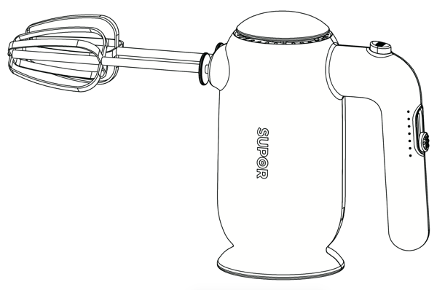
Out Shell
Cooling Punch
Stirring Rod
To protect the whisk
Maintain a stable body temperature
Effectively stir objects
Return Bar Key
Easy disassembly
Round Sheet Metal
Prevent objects from splashing into the interior
Adjust The Gear Key
Perfect speed adjustment
Circular Base
Effectively maintain steady standing
Hand Shank
Excellent ergonomic design

Slide 3
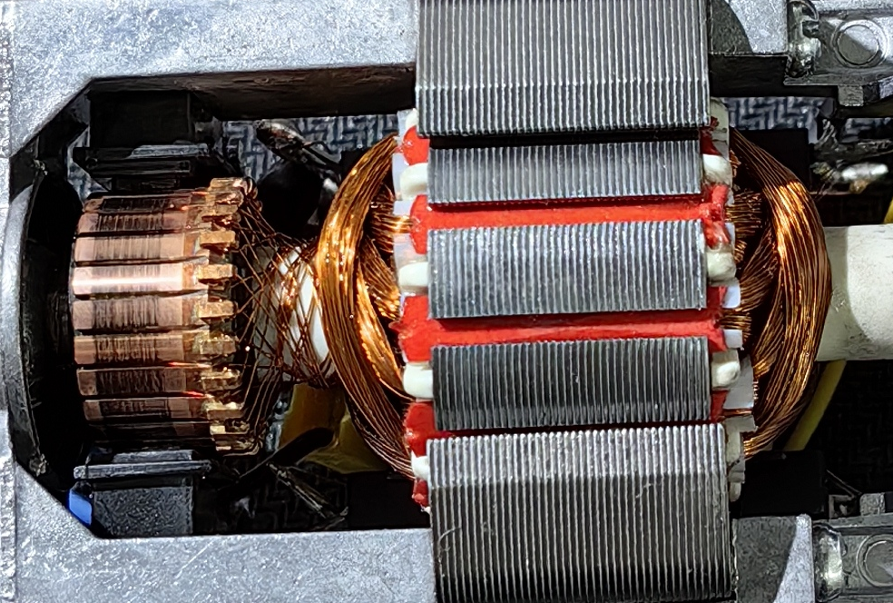
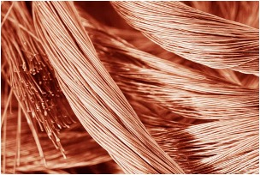
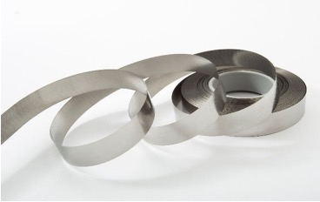
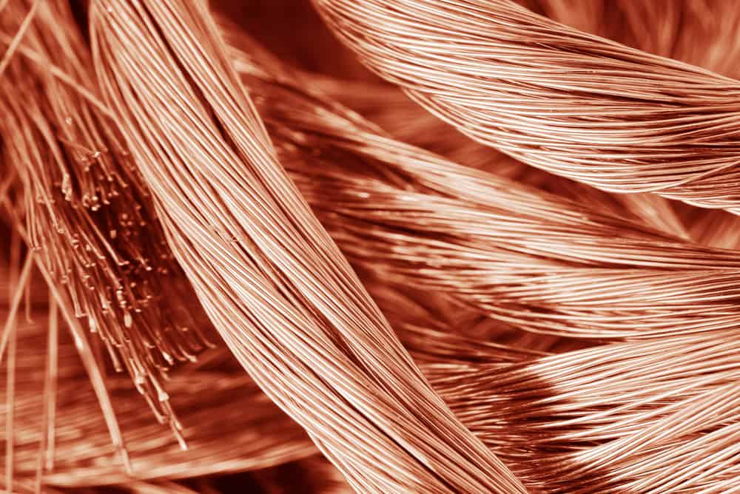
soft magnetism
The magnetic flux becomes larger
Energy loss reduction
Calorific reduction
Copper
Soft Magnetism

Slide 4
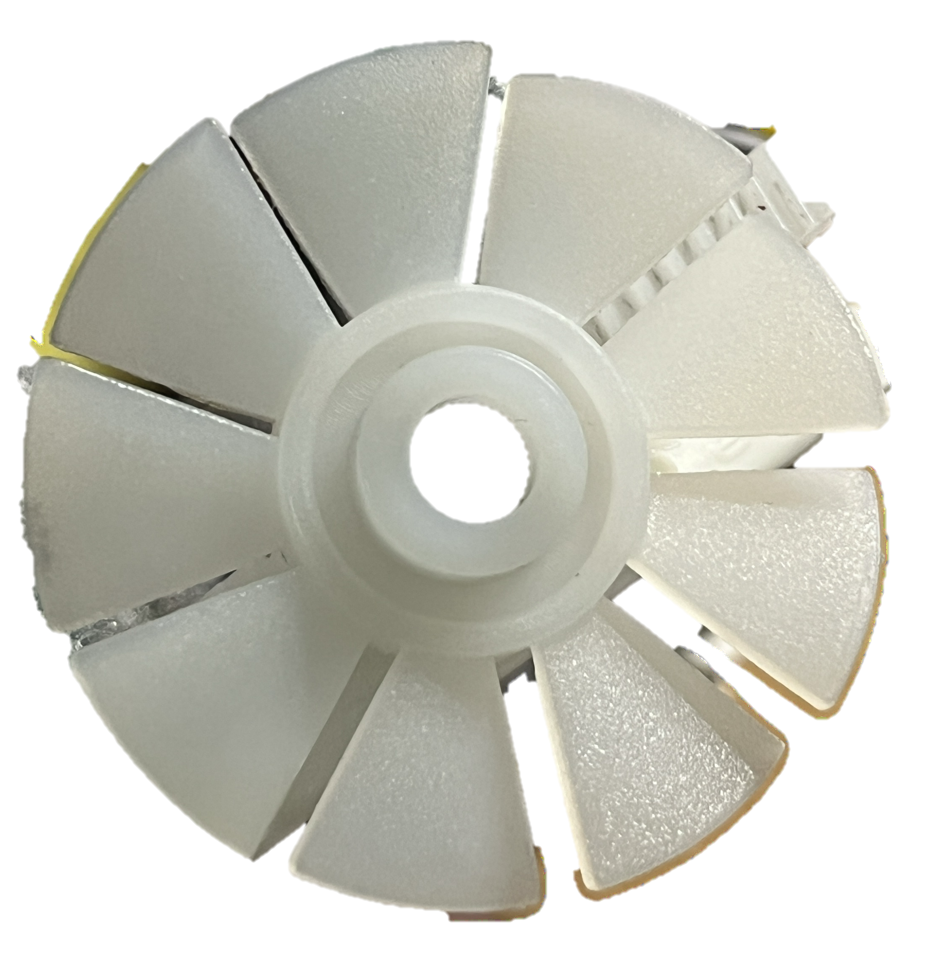
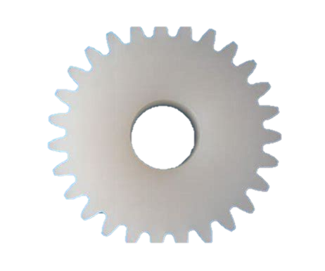
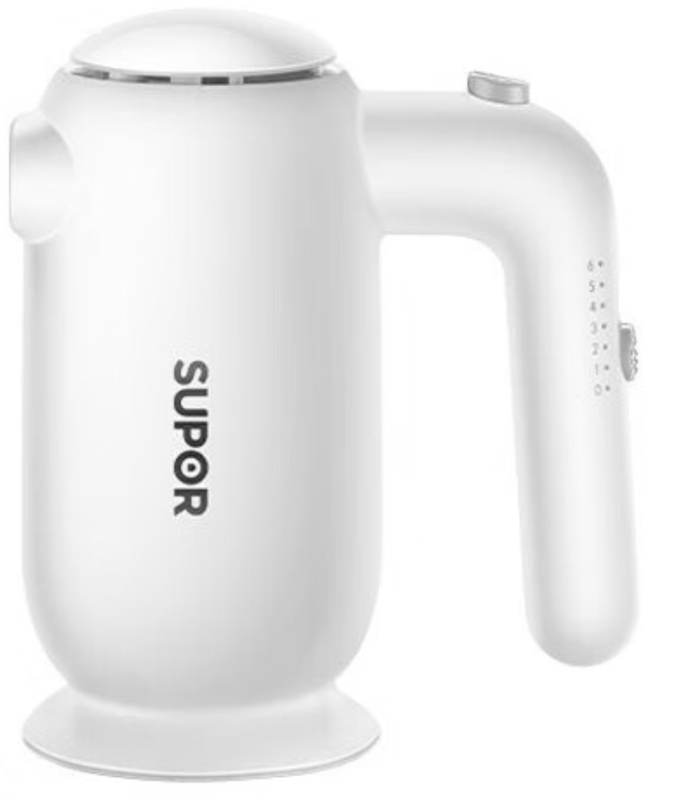
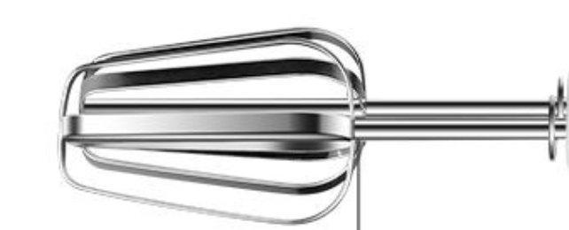
Press

